Slide 1
Are You an Accident
of Nature?
Notes:
Add link to this YouTube excellent video, 5 minutes, for showing educators folly of evolution
https://www.youtube.com/watch?v=ko3tEYNXFHo
Pleiotropy (from Greek πλείων pleion, "more", and τρόπος tropos, "way") occurs when one gene influences two or more seemingly unrelated phenotypic traits. How can you have a small change in a pleiotropic gene that does not ruin its other functions? A big problem.

Slide 2
Ignorant
to believe in evolution

Slide 3
Scientifically

Slide 4
Information cannot be created by chance:
To start life
To change simple life into complex life
Notes:
Show this scientifically and rigorously
Sloppy science. Not real science.

Slide 5
We Know:
The DNA code for proteins
Probability we could get a protein by chance
Not remotely possible we could get the DNA for a single typical protein by chance (see later video)

Slide 6
Evolution is guesses and assumptions pretending to be science.
Lacks rigor.

Slide 7
Evolution Words
Maybe
It could be
It is thought
This suggests
Perhaps

Slide 8
True
Natural Selection
Survival of the fittest

Slide 9
True
Adaptation
Organism can change in response to environment
finches with small or big beaks
occurs without adding new information to the genome
Genes are selected or expressed, not new genes created.

Slide 10
Evolution
Requires increasing the complexity of information in a genome (species)

Slide 11
Provable Fact
Mutations plus natural selection can NOT increase the complexity of information
in a genome (species).

Slide 12
Evolution requires believing things we know are not true.
No information by chance
Chemistry prevents life from non-life anywhere in any universe

Slide 13
Fossil Record
Transitions missing
Fossils appear out of sequence

Slide 14

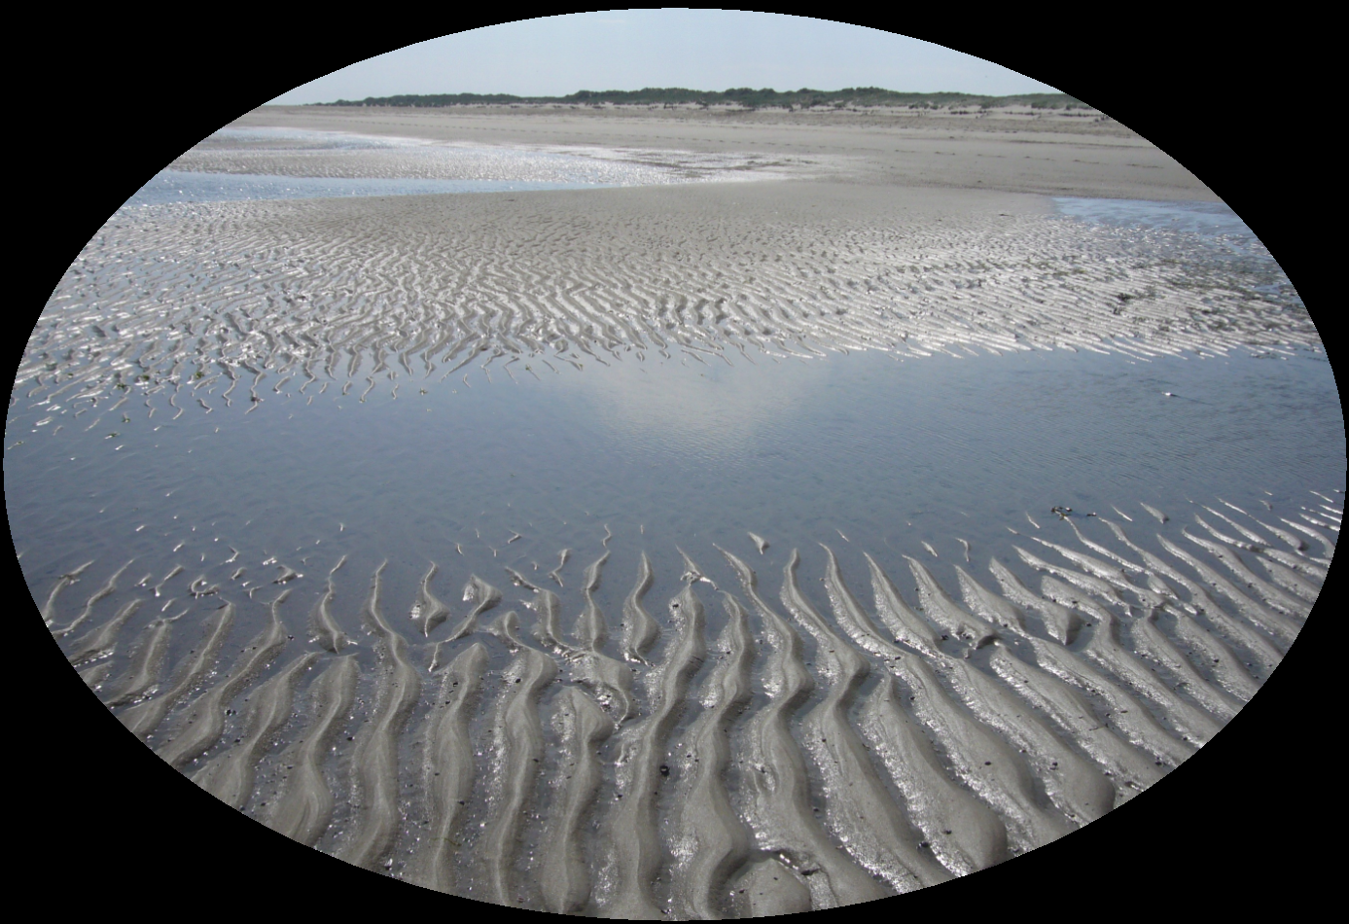
God
Where did you come from?
Mud
Notes:
God created you.
You are an accident of nature.
Produced by undirected chemistry.
Evolution

Slide 15

Righteous
God
Where will I go when I die?
Mud
Hell

Slide 16
Please see videos in series for more details:
Are You an Accident of Nature?
  Educate7.com
  How7.org
  Youtube

